Slide 1

A Mini Project Report on
“E-Challan Retrieval Using LPR”
Submitted to
OSMANIA UNIVERSITY, Hyderabad
In partial fulfillment of the requirements for the award of degree
BACHELOR OF ENGINEERING
in
COMPUTER SCIENCE AND ENGINEERING WITH DATA SCIENCE
Under the guidance of
Dr. Mohammad Sanaullah Qaseem
Prof. and Head of CSE department
Submitted by ​
​
SYED MAHMOOD 161020750018 ​
​
SYED AZEEMUDDIN 161020750015
​
MOHD ABUZAR SUFIYAN 161020750010 ​
Project Coordinator
Dr. Mohammed Sanaullah Qaseem
Internal Supervisor
Dr. Mohammed Sanaullah Qaseem

Slide 2
Content
Introduction
Problem and Cause (What? and Why?)
Existing System
Proposed System
Advantages
Additional Features
Conclusion

Slide 3
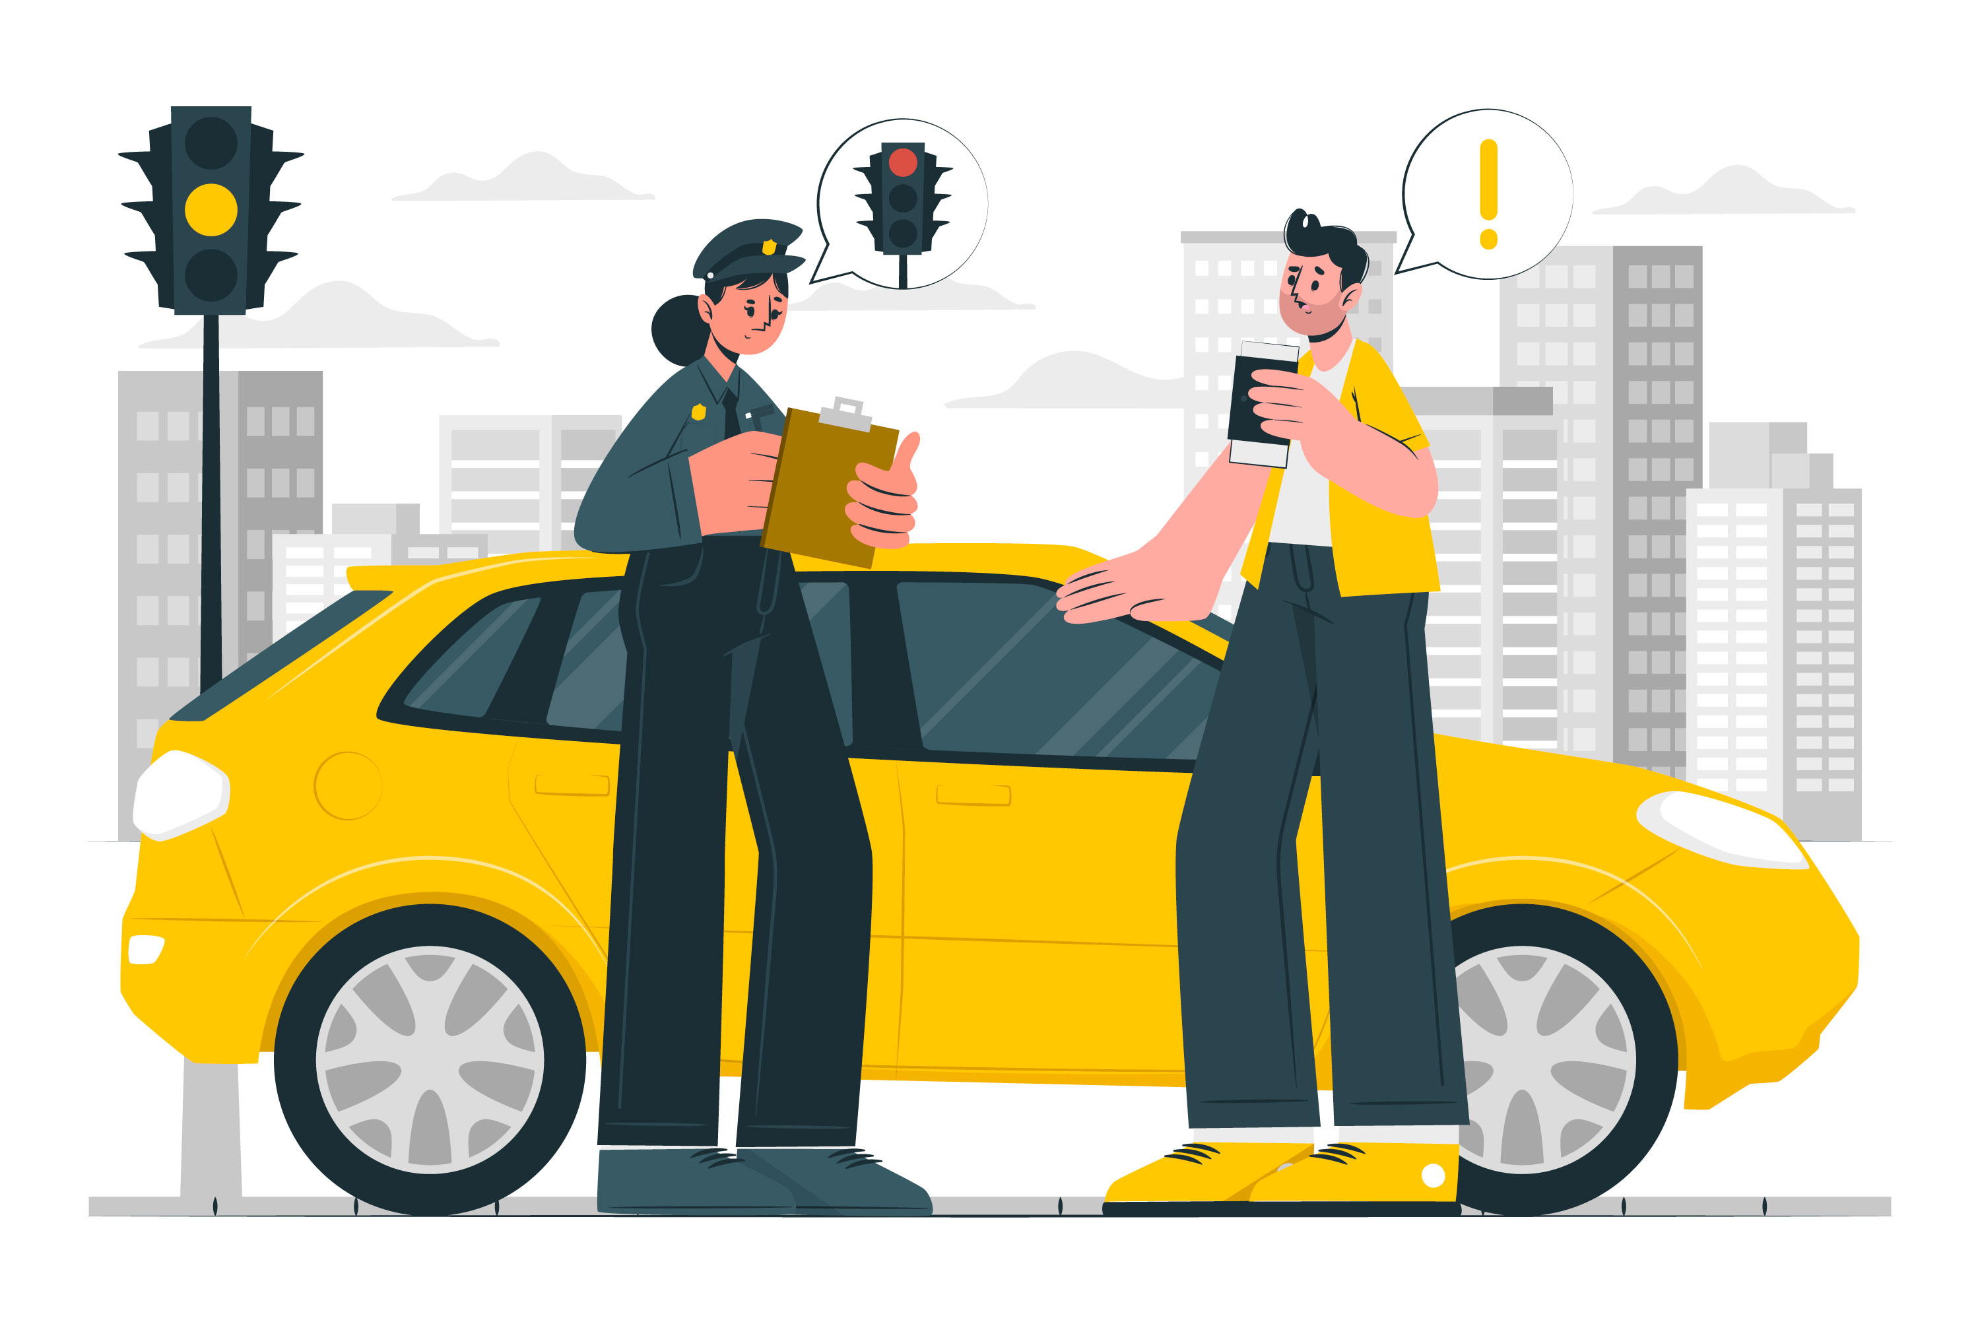
Introduction
Challan is an official document issued to a motor vehicle driver who violates traffic rules and regulations.
According to the Motor Vehicles Act, When a traffic challan is issued in your name, it means you are responsible for paying the penalty, which varies depending on the type of offense committed.
E-Challan is the electronic form of the regular physical challan issued for traffic violations for both cars and bikes.

Slide 4

Problem Statement (What?)
Retrieving the E-Challan is pivotal within the E-Challan process, enabling individuals to verify fines tied to traffic violations, gain insights into their driving habits, and uphold legal compliance.
It provides a means for individuals to review details such as the type of violation, date and time of occurrence, location, and the corresponding fine amount.
The problem statement revolves around enhancing the efficiency and effectiveness of the E-Challan retrieval process to promote road safety and ensure legal compliance.

Slide 5

Existing System
In the existing system, users are required to visit a website and manually enter their license plate details, along with completing a captcha for verification purposes.
This process involves several steps:
Website Visit: Users navigate to a specific website designated for E-Challan retrieval or processing (https://echallan.tspolice.gov.in/publicview/ in case of Telangana)
License Plate Entry: Upon arrival at the website, users are prompted to enter their license plate details. This typically includes the alphanumeric characters displayed on their vehicle's license plate.
Captcha Entry: In addition to the license plate details, users are required to complete a captcha. Captchas are used to verify that the user is a human rather than a computer program attempting to automate the process.

Slide 6
4 .Submission: After entering their license plate details and completing the captcha, users submit the information through the website.
5 .Processing: The entered data is processed by the website's backend system, which retrieves the corresponding E-Challan information associated with the provided license plate details.
6. Response: Once the processing is complete, users receive a response from the website, typically displaying the retrieved E-Challan details, such as violation type, fine amount, payment status, and any additional information.
This existing system requires manual input from users for both the license plate details and the captcha, which can be time-consuming and prone to errors. Additionally, the captcha adds an extra step for user verification, which may be inconvenient for users.

Slide 7
Proposed System
The proposed solution entails the development and deployment of a License Plate Recognition (LPR) model leveraging advanced computer vision techniques.
This model would be designed to automatically detect and recognize individual characters comprising a license plate, eliminating the necessity for users to manually input this information.
By harnessing machine learning algorithms, the system would be trained on vast datasets of license plate images, allowing it to accurately identify and interpret various license plate formats, fonts, and styles.
Through this approach, users would experience enhanced convenience and efficiency when accessing E-Challan information, as they would no longer need to tediously enter license plate details themselves. Instead, the system would seamlessly process images captured by cameras or uploaded by users, rapidly extracting the relevant information for further processing.

Slide 8
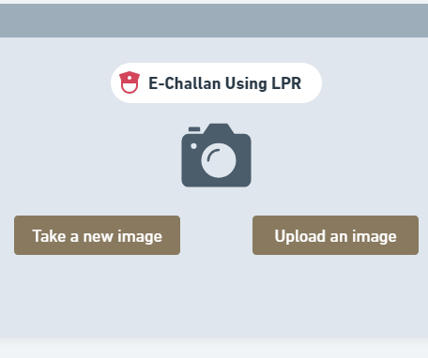
Innovative Process
Image Selection or Upload: Users capture or upload an image containing a vehicle's license plate, typically done through a web interface or mobile application.
License Plate Recognition (LPR): The LPR model analyzes the uploaded image using computer vision techniques, identifying and isolating the region containing the license plate.
Character Recognition: The LPR model processes the license plate region to recognize individual characters (letters and numbers) using machine learning algorithms trained on license plate datasets.
Text Extraction: Recognized characters are extracted from the license plate region as a string of alphanumeric characters.
E-Challan Retrieval: The extracted license plate number is used to query the database for associated E-Challan records, retrieving relevant information such as violation type, fine amount, and payment status.

Slide 9
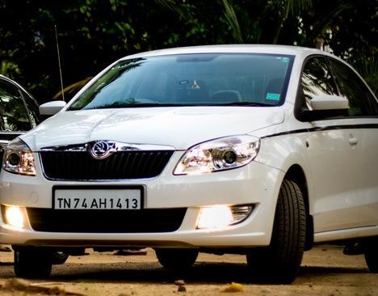
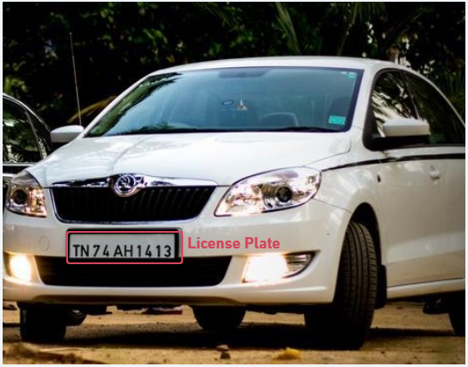
For Example
Uploading image of a car
Model recognizing the license plate

Slide 10
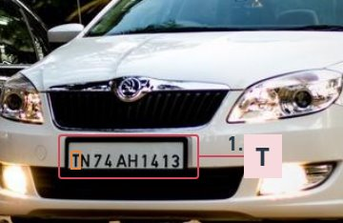
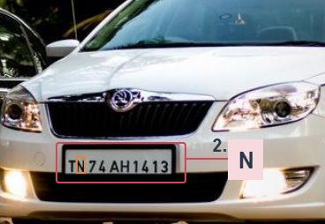
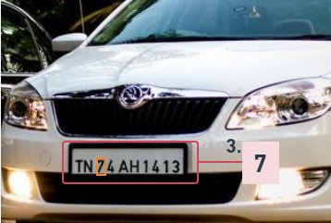
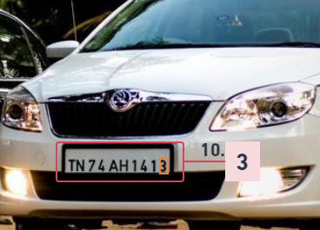
3. Optical character recognizer extracting letters one by one
….....
Text Extraction
TN74 AH 1413

Slide 11
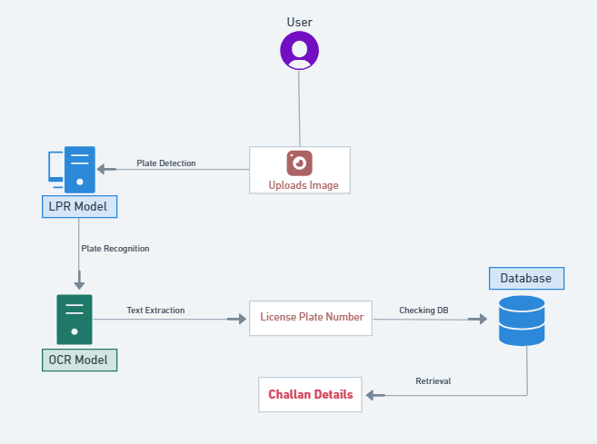
Use Case Diagram

Slide 12

Advantages over conventional system
Improved Efficiency: Automating the process of license plate recognition eliminates the need for manual entry, resulting in faster retrieval of E-Challan information for users.
Enhanced Accuracy: Leveraging machine learning algorithms enhances the accuracy of license plate recognition, reducing errors associated with manual data entry.
Reduced User Effort: Users no longer need to manually type out their license plate details, reducing effort and streamlining the retrieval process.
Convenience: The automated recognition of license plates offers a more convenient experience for users, making it easier to access E-Challan information on-the-go.

Slide 13
Additional Features
By incorporating these additional features alongside the LPR model, we gain deeper insights into traffic violations.
Some of the features are:
Visual Analytics: Provide visual details about the distribution of E-Challans in a particular area. This could include heatmaps or geographical representations showing areas with the highest concentration of violations.
Violation Trends Analysis: Analyze historical data from E-Challans to identify trends in violations per area over time. This can help authorities understand patterns of traffic violations and allocate resources effectively for enforcement and intervention.
Time-Based Analysis: Explore time-based trends in violations, such as peak hours or days with the highest number of violations. This information can inform strategies for targeted enforcement and traffic management interventions during specific times.

Slide 14
Scope of the App
Here's an overview of the potential applications and benefits:
Introduction to Handheld LPR Devices: By integrating the LPR model with portable hardware platforms such as Raspberry Pi or Jetson Nano, these devices offer a compact and versatile solution for capturing and analyzing license plate information in real-time.
Mobile Enforcement Devices: Handheld devices equipped with the LPR model can be used by law enforcement officers for on-the-go monitoring and enforcement of traffic violations. Officers can quickly capture images of vehicles' license plates using the device, and the LPR model can instantly analyze the images to identify any associated violations.
Traffic Surveillance: Handheld devices equipped with LPR capabilities can be used for traffic surveillance in areas with high traffic volume or congestion. Officers can monitor traffic flow and identify vehicles involved in accidents or traffic violations in real-time, facilitating rapid response and intervention.
Vehicle Registration and Identification: Handheld LPR devices can also be used for vehicle registration and identification purposes.

Slide 15
Conclusion
In conclusion, the proposed solution of implementing a License Plate Recognition (LPR) model using computer vision technology offers a streamlined and efficient approach to retrieving E-Challan information.
By allowing users to simply select or upload an image containing a vehicle's license plate, the LPR model automates the process of license plate recognition, eliminating the need for manual data entry.
By seamlessly integrating technology and automation, the proposed solution represents a significant advancement in the realm of traffic management and enforcement, ultimately contributing to safer roads and improved user experiences.

Slide 16
Thank you.

